Slide 1

MAJOR PROJECT
ON
DETECTION OF MALARIA USING CONVOLUTIONAL NEURAL NETWORK(CNN)

Slide 2
Submitted to Guide : Mrs. A. LEELA SRAVANTHI
Assistant professor Department Of INFORMATION TECHNOLOGY Project Batch - 22
V. ABHINAV SAI - 207Y1A1201
B. BHARGAVI - 207Y1A1207
G. SRIVALLY - 207Y1A1251

Slide 3
CONTENTS:
Introduction
Abstract.
Literature Survey.
Existing System.
Proposed System.
Requirements.
Algorithm
Input & Output
Conclusion
Reference

Slide 4
Introduction
Malaria is a deadly disease that is difficult to diagnose using traditional methods.
Machine learning algorithms have been used to diagnose malaria in the past, but they have not been very successful.
This project proposes a new deep learning model based on a convolutional neural network (CNN) that is more accurate than previous models.
The CNN model was trained on a dataset of 27,558 single-cell images.
Three different CNN models were compared: Basic CNN, VGG-19 Frozen CNN, and VGG-19 Fine Tuned CNN.
The VGG-19 Fine Tuned CNN model was the most accurate of the three models.
The CNN model could be used to diagnose malaria in resource-limited settings.

Slide 5
ABSTRACT
Malaria poses a significant challenge for health departments worldwide, with traditional diagnosis relying on manual examination of blood smears under a microscope by skilled technicians. This method is time-consuming and dependent on the expertise of the examiner.
To address this, a new machine learning model based on Convolutional Neural Networks (CNNs) is proposed. This model aims to automatically classify and predict infected cells in thin blood smears, streamlining the diagnostic process.
The study compares three CNN models—Basic CNN, VGG-19 Frozen CNN, and VGG-19 Fine Tuned CNN—using a ten-fold cross-validation on 27,558 single-cell images. The model with the highest accuracy is identified for improved malaria diagnosis.

Slide 6
Literature Survey
S.No | Title | Author & Year | Method | Merit | Demerit
1 | Detection of malaria parasites using digital image processing | A. Bashir, Z. A. Mustafa, I. Abdelhameid and R. Ibrahem, 2017 | Uses ANN classifier for detection of malarial parasites | Accurate, rapid and affordable | Not fully automatic diagnosis method
2 | Automated image processing method for the diagnosis and classification of malaria on thin blood smears | Nicholas E. Ross., Charles J. Pitchard., David M. Rubin and Adriano G. Duse., 2020 | An image processing algorithm to automate the diagnosis of malaria on thin blood smears is developed | Highly sensitive at diagnosing a complete sample | False-negative detection occurred in several challenging situations
3 | Malaria Detection using Deep Learning | G. Shekar, S. Revathy and E. K. Goud, 2020 | Highly robust machine learning model based on CNN | High accuracy rate and low time duration | Very cost-effective process

Slide 7
Existing System.
Previously, they used machine learning algorithms, which are time-consuming and require skilled workers. This process is time-consuming and relies on the expertise of the examiner.
To improve this, a new machine learning model based on Convolutional Neural Networks (CNNs) is proposed. The model automatically analyzes thin blood smears to classify and predict infected cells, making the diagnostic process more efficient.

Slide 8
Disadvantages
Well knowledgeable person needed for the examination.
Inefficient.
Low accuracy.
High time consumption.

Slide 9
Proposed System
This paper proposes a new and highly robust machine learning model based on a Convolutional Neural Network (CNN) which automatically classifies and predicts infected cells in thin blood smears on standard microscope slides.
The proposed work starts with decision taking whether the cell is infected or not.
Then start training the machine by giving all the attributes of the images.
Once all the images are acquired, the training process gets started followed by validation, and testing.
After receiving desired accuracy, the developed model is ready for use with real malaria samples.

Slide 10
Advantages of Proposed System
High accuracy.
Low time consumption.
No need for any qualified technicians.

Slide 11
Requirements:
Hardware Requirements:
Software Requirements:
Processor : Intel Core i3 and above.
RAM : 4 GB (min).
Hard Disk : 20 GB.
Key Board : Standard Windows Keyboard.
Mouse : Two or Three Button Mouse.
Operating system : Windows 7 and above.
Coding Language : Python.
Deep Learning Framework : TensorFlow
Image Processing Tools : OpenCV

Slide 12
Algorithm
Convolutional Neural Network (CNN)
A convolutional neural network (CNN) is a type of artificial neural network used in image recognition and processing that is specifically designed to process pixel data.
A convolutional neural network, or ConvNet, is just a neural network that uses convolution.
In the case of CNN, convolution is applied to the input data to filter the information and produce a feature map.
The goal of CNN is to reduce the images so that it would be easier to process without losing features that are valuable for accurate prediction.

Slide 13
Modules
Data Collection
Pre-processing
Feature Extraction
Model Training using CNN
Evaluation

Slide 14
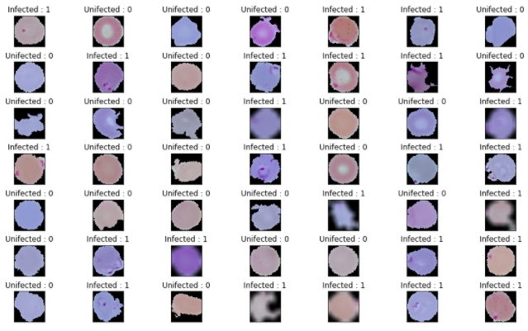
Input

Slide 15
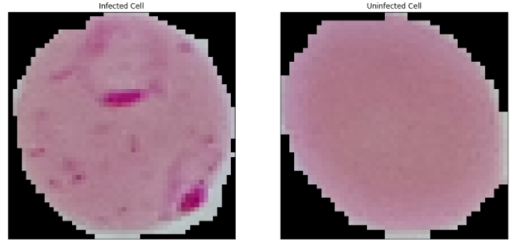
Sample of blood cell images of both healthy and infected

Slide 16
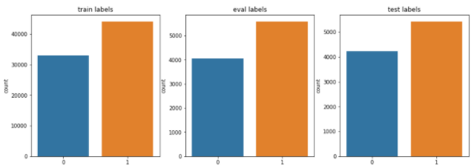
Dataset Split

Slide 17
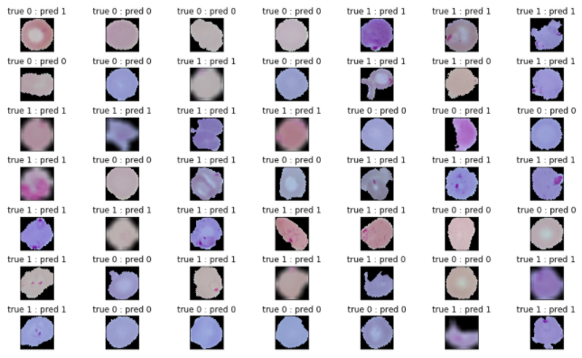
Output

Slide 18
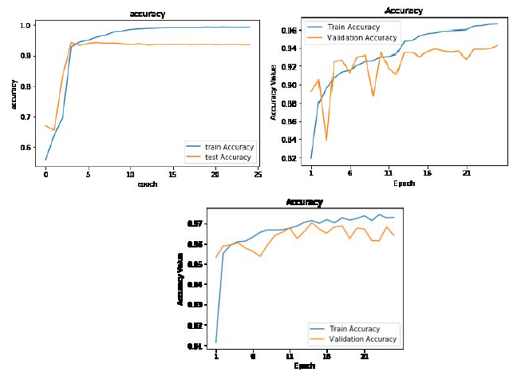
Performance Evaluation

Slide 19
Conclusion
The main aim of this proposed work is to develop an efficient deep learning model to predict Malaria disease.
Malaria detected from the traditional method, that is bringing the samples and analyzing cell growth requires more time.
In the proposed system, a deep learning model based on CNN algorithm has been constructed to predict Malaria with a high accuracy rate and low time duration.
The proposed CNN model is constructed and identified as the highest accuracy model.

Slide 20
References
A. Bashir, Z. A. Mustafa, I. Abdelhameid and R. Ibrahem, "Detection of malaria parasites using digital image processing," IEEE 2017, International Conference on Communication, Control, Computing and Electronics Engineering (ICCCCEE), 2017, pp. 1-5
Nicholas E. Ross., Charles J. Pitchard., David M. Rubin and Adriano G. Duse “Automated image processing method for the diagnosis and classification of malaria on thin blood smears” IEEE Vol.44. 2020.
G. Shekar, S. Revathy and E. K. Goud, "Malaria Detection using Deep Learning," 2020 4th International Conference on Trends in Electronics and Informatics (ICOEI)(48184), IEEE 2020, pp. 746-750
Vishnu V. Makkapati and Raghuveer M. Rao., “Segmentation of malarial parasites in peripheral blood smear images” IEEE International Conference on Acoustics, Speech and Signal Processing. 2009.
Yang F, Poostchi M, Yu H, et al., “Deep learning for smartphone-based malaria parasite detection in thick blood smears”. IEEE J Biomed Health Inform. 2019;(September):1-1.
A. Anand, V. K. Chhaniwal, N. R. Patel and B. Javidi, "Automatic identification of malaria-infected RBC with digital holographic microscopy using correlation algorithms", IEEE Photonics J., vol. 4, no. 5, pp. 1456-1464, 2012.

Slide 21


